Slide 1
IBM Capstone project
Italian Restaurants
By: Xavier Lowe

Slide 2
Overview
This final project explores the best locations for Italian restaurants throughout the city of New York.
Goal:Questions to answer
What is / are the best location(s) for Italian cuisine in New York City?
In what Neighborhood and/or borough should I open an Italian restaurant to have the best chance of being successful?
Where would I go in New York City to have the best Italian food?

Slide 3
DATA
New York City data containing the neighborhoods and boroughs, latitudes, and longitudes will be obtained from the data source: https://cocl.us/new_york_dataset
New York City data containing neighborhood boundaries will be obtained from the data source: https://data.cityofnewyork.us/City-Government/Borough-Boundaries/tqmj-j8zm
**All data related to locations and quality of Italian restaurants will be obtained via the Four Square API utilized via the Request library in Python. The different data points and services will be used to create an overall data frame that can be used to analyze the population density, restaurant location density and other variables as it pertains to the analysis.

Slide 4
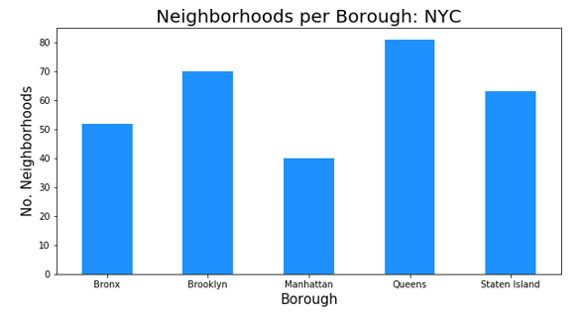
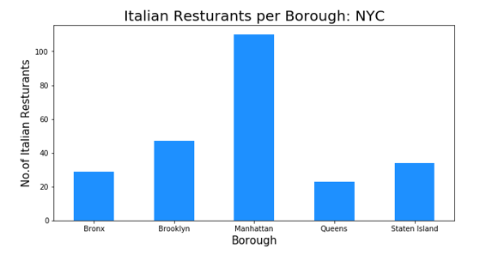
METHODOLOGY
Data will be collected from https://cocl.us/new_york_dataset and cleaned and processed into a data frame.
Four Square be used to locate all venues and then filtered by Italian restaurants. Ratings, tips, and likes by users will be counted and added to the dataframe.
Neighborhoods per Borough
Italian Restaurants per Borough
Average Rating per neighborhood
Average Rating per neighborhood per borough

Slide 5
Results / Discussion
Manhattan and Queens have the best rated Italian restaurants on average. Queens and The Bronx have the least amount of Italian restaurants per borough. However, of note, Belmont of The Bronx is the neighborhood in all of NYC with the most Italian Restaurants. Despite Manhattan having the least number of neighborhoods in all five boroughs, it has the most Italian restaurants.
Based upon the analysis:
What is / are the best location(s) for Italian cuisine in New York City?
Manhattan
In what Neighborhood and/or borough should I open an Italian restaurant to have the best chance of being successful?
Queens
Where would I go in New York City to have the best Italian food?
Gramercy

Slide 6
conclusion
This final project explores the best locations for Italian restaurants throughout the city of New York and therefore where there would be the best opportunity to create a new establishment. It is to be noted that this analysis is not to be used as the only data points determined to help produce a qualifying decision as there are other variables that are not accounted for in the analysis

